Slide 1
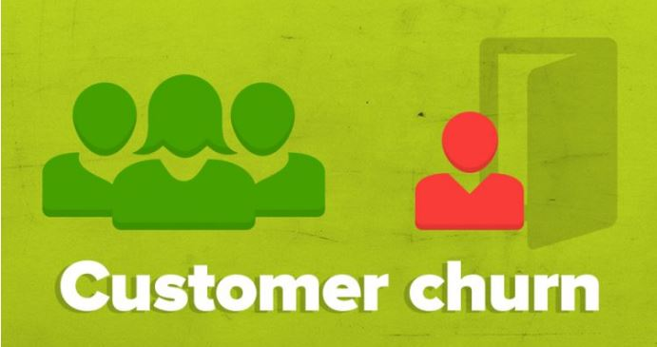
Customer Churn
Ways to find Customer Churn

Slide 2
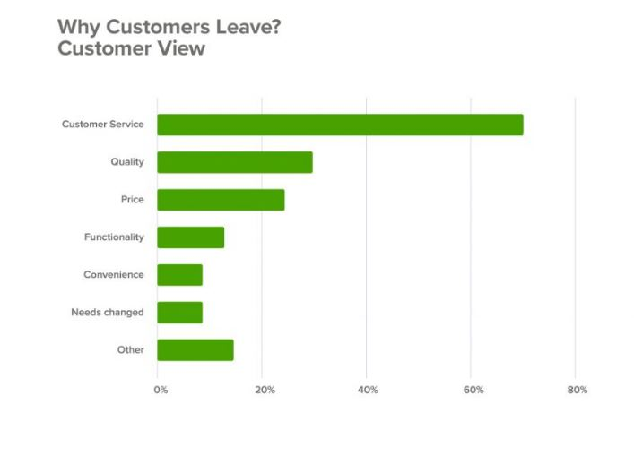
Problem and Impact
Finding ways to reduce customer churn
When customers are unhappy, they stop doing business with you. It’s that simple. The more customers that leave, the less you grow. If you want to keep your customers, then you need to address customer churn.
Customer churn has a significant impact on your business as it lowers revenues and profits. Yet surprisingly, more than 2 out of 3 companies have no strategy for preventing customer churn.
Here, we focus on reducing customer churn and build relationships with your existing customers, so that we keep customers happy and loyal.
American College of Cardiology
New England Healthcare Institute. ‘Thinking outside the pillbox via Healthcare insights; Express Scripts Lab;

Slide 3
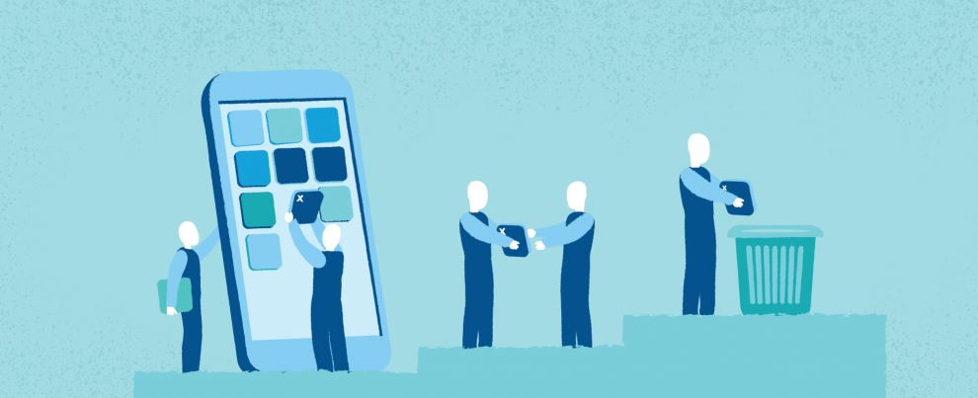

Solving this big problem
Strategies, Personalized Interventions, Offers and Rewards
Analyze why churn occurs
Engage with your customers
Educate the customer
Know who is at risk
Define your most valuable customers
Offer incentives
Target the right audience
Give better service
Pay attention to complaints
Offer a long term contract
Make your best people deal with cancellations
sFlaunt your competitive advantages

Slide 4

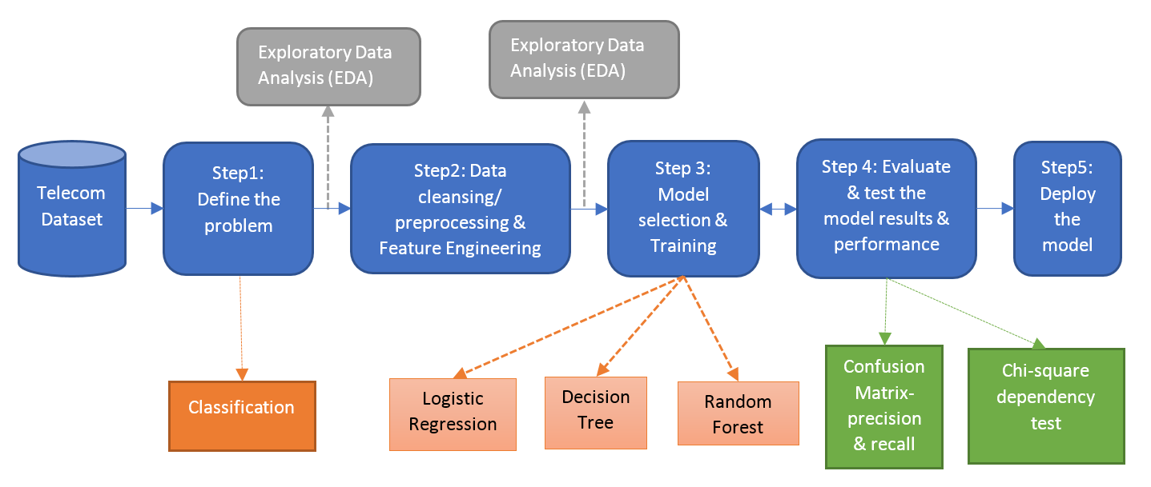
How it works?
Customer
PROFILE
Mobile Number: 327-1058
State: OK
Makes roughly around 76 day calls, 100 Night calls
Customer Interaction

Slide 5
Solution – Demo

Slide 6
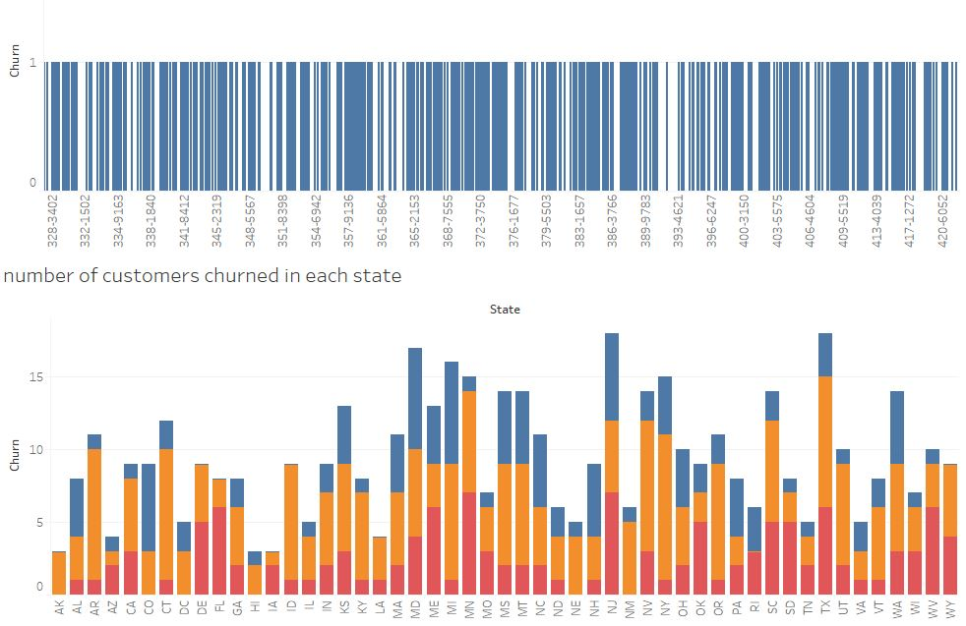
A glance at raw data
Features
State
Area Code
Phone
Account Length
VMail Message
Day Mins
Eve Mins
Night Mins
Intl Mins
CustServ Calls
Int'l Plan
VMail Plan
Day Calls
Day Charge
Eve Calls
Eve Charg
Night Calls
Night Charg
Intl Call
Intl Charge
Churn

Slide 7
Data Engineering done
Problem at hand
Keeping your customers is not magic. It all boils down to analyzing the reasons behind churn and then acting on them. Improve your customer service levels and make sure they see what they are gaining if they stay with you, rather than stray away from you.
Analytics Solution Framework Implemented
1. Data Preprocessing – Imputation & type conversion
2. Derive Features based on existing ones
8. Finalize the Model for the best fit
3. Plotting and Visualizing the data
7. Compare accuracy and results of various models
4. Get Insights and document them
5. Enrich data based on the Insights
6. Freeze data frame to feed into models

Slide 8
Important conclusions
Derived fields
Now that we have established that you simply cannot afford to lose customers, it is better to focus on being a keeper. That means that your customers have to clearly see why it is better to keep you and stay with you instead of leaving.
And you’d better be proactive in how you prevent customer churn by creating the conditions in which customers would clearly see and make use of the benefits your products offer.
Keep in mind that 80% of a company’s future revenue comes from just 20% of its existing customers. You can’t deny that is a lot.
Classification Models(Multinomial Logistic Regression and RandomForest):
To find whether the customer will churn or not based on the useage of net work till date.
The classification model with some accuracy will also be able to predict churn for the new existing customers based on the demographic attributes.

Slide 9
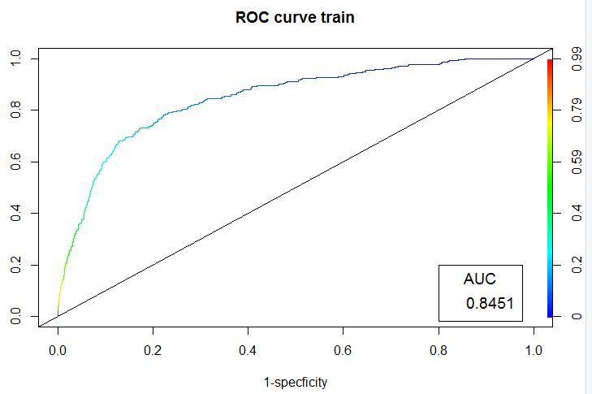
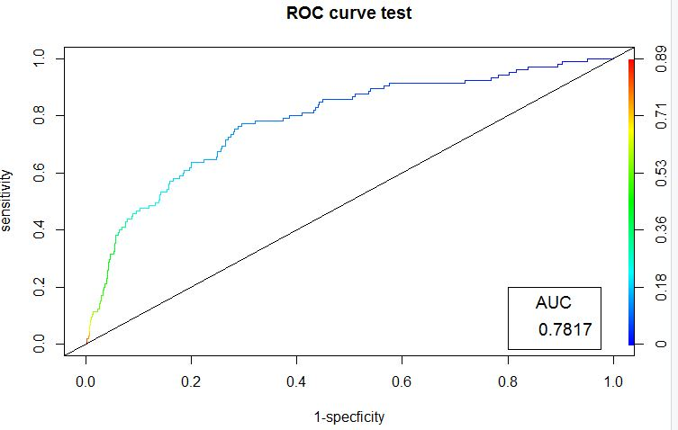
Model output results
Logistic Regression Results
Our Logistic Regression model predicts adherence class of a patient with approximately 85.49 % accuracy for the “Test” data
Data | Accuracy | Precision | Recall
Train | 87.07224 | 88.83022 | 97.11368
Test | 85.49075 | 87.46224 | 96.82274
By looking at the Precision and Recall results we can say that the prediction of True positives and True Negatives is reasonably good and ROC curve also depicts this.

Slide 10
Impact
Network
Throttle overall customers
Increased customer engagement
Limit churn
Flexibility to scale up
Customers
Improved overall quality of connectivity.
Better Customer service.
Good Offers.

Slide 11
Feature Engineering
Data Wrangling
Imputation
While analyzing the data we found out there are no values to impute.
Data Types
State, Churn has been changed to factor. Phone has been changed to Numeric.
Columns have been Re-Arranged.
Total data Set has been partitioned to: Train(80% data) & Test(20% data).
Derived fields
The following columns and data frames have been derived from master dataset for processing purpose.
State
This is the attribute which carries the state name.
Area Code
This field represents Area Code.
Phone
This field has the phone number of the customer.
Churn
This is a simple binary categorical representation of the churn of the customer on Mobile Network usage. This is 0 (Not-Churned) and
1 (Churned) otherwise.

